Slide 1
Boost converter design
Jorge Leonardo Chaparro Sarmiento.
Luis Felipe Narváez Gómez.
Facultad de Ingeniería Electrónica.
Universidad Santo Tomás, Seccional Tunja.
2020-1.

Slide 2
Introduction:
DC/AC, AC/DC, AC/AC, DC/DC converters.
DC/DC converter → Increases or decreases the input voltage.
Boost Converter → DC/DC converter → Theorical
Analysis
→ Simulation
→ Design of PCB for the Controlled Converter.

Slide 3
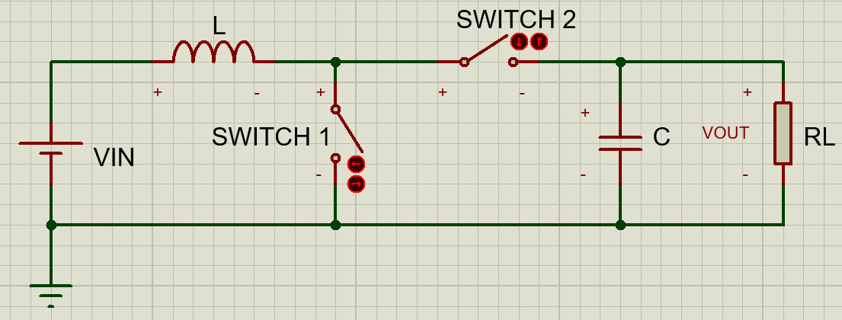
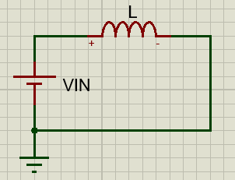
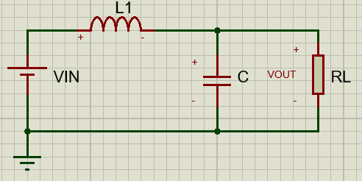
Fundamentals:
Schematic Circuit
Circuit for 0<t<DT
Circuit for DT<t<T

Slide 4
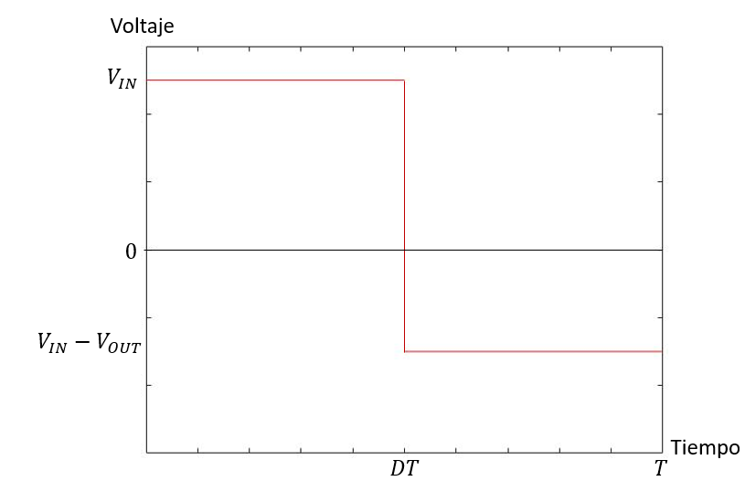
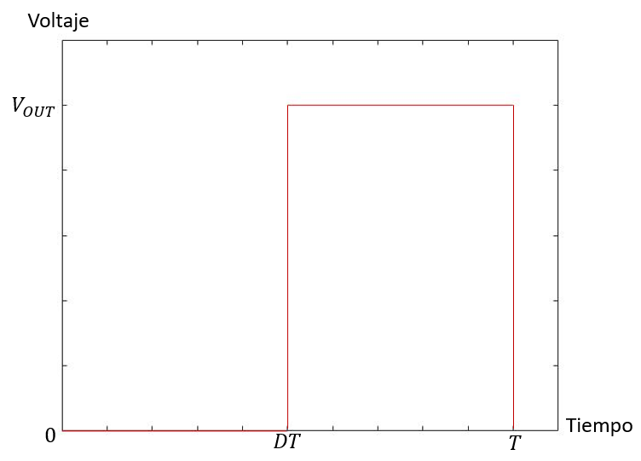
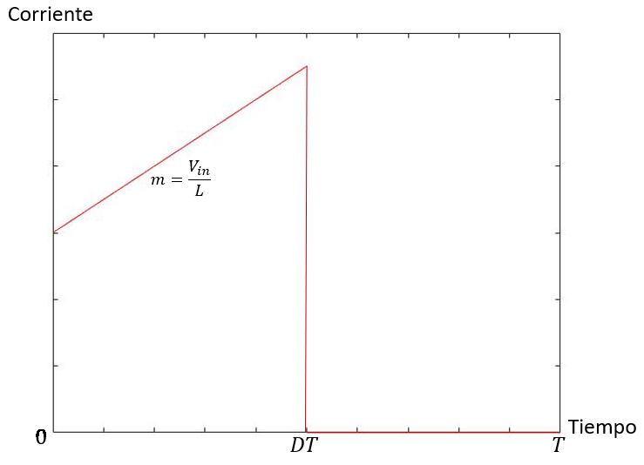
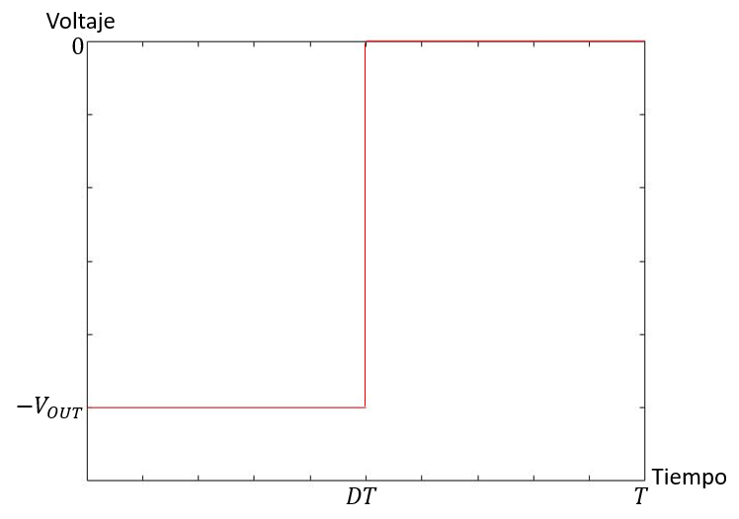
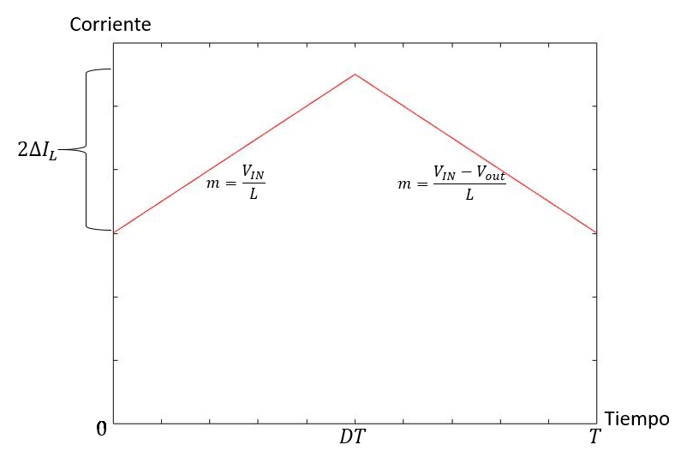
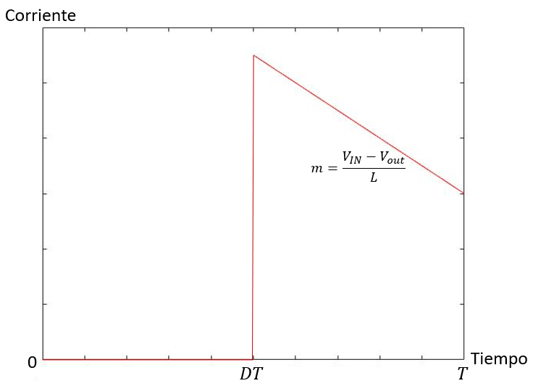

Wave Forms
Voltage on S1
Voltage on L
$$I_{L}=\frac{1}{L}\int_{0}^{T}{V_{L}dt=0}$$
Current through S1
Voltage on S2
Current through L
Current through S2

Slide 5
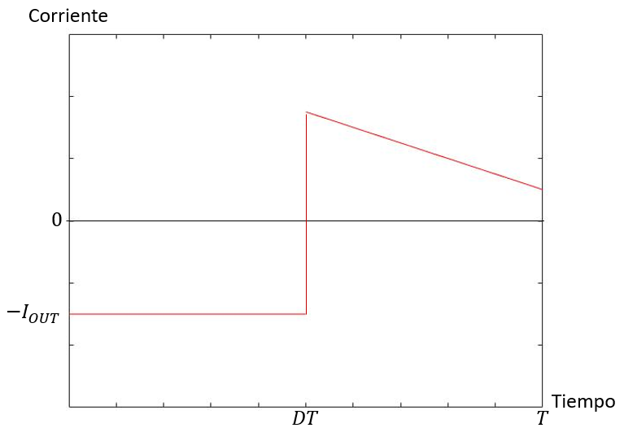
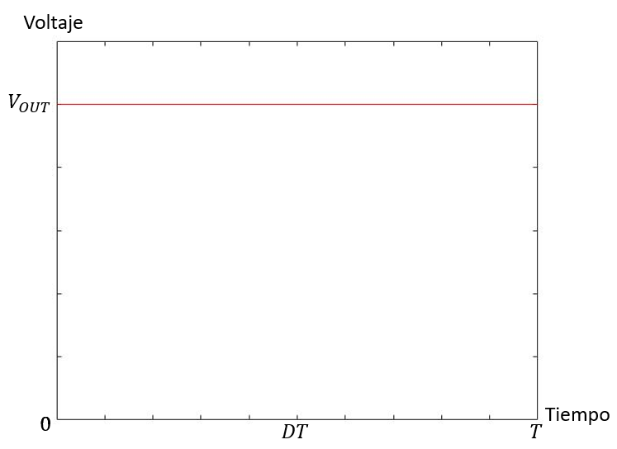
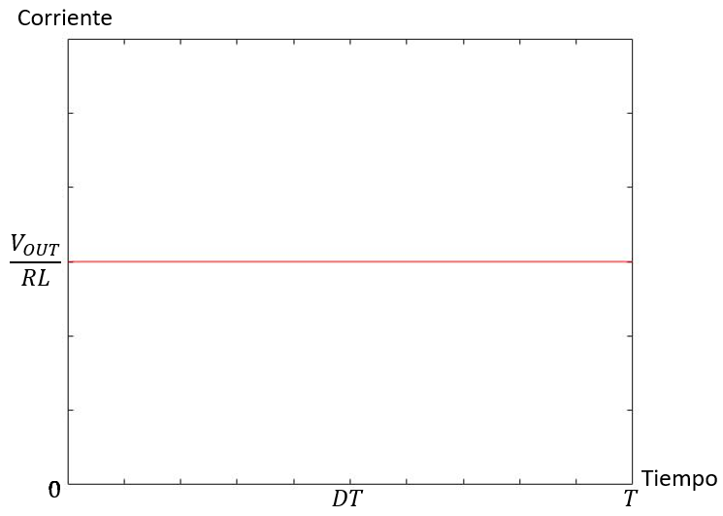
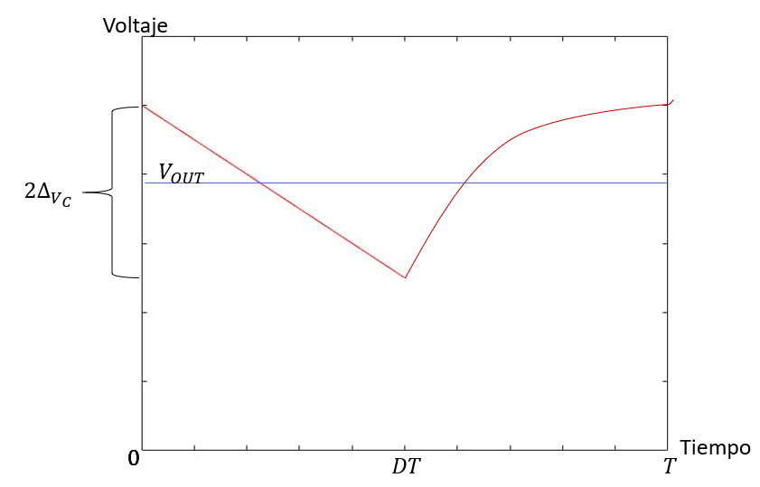

Wave Forms:
Current through C
Voltage on RL
$$V_{c}=\frac{1}{C}\int_{0}^{T}{I_{c}dt}$$
Current through RL
Voltage on C

Slide 6

Equations:
To find L value:
$2∆I_{L}=\frac{V_{IN}}{L}\left(DT\right)$ → $L=\frac{V_{IN}D}{2f∆I_{L}}$ $5\%<∆I_{L}<15\%$
To find C value:
$Q=V_{C} C$ → $Q=\int{i_{c}}$ → $−\frac{V_{OUT}}{RL}DT=2∆V_{C} C$ → $C=−\frac{V_{OUT}D}{2Rf∆V_{C}}$ 1% <$∆V_{C}<2\%$

Slide 7
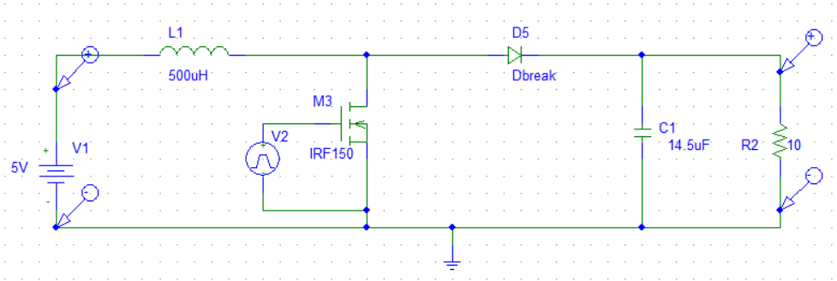
Development:
Simulated analysis:
Vin=5V, Vout=12V, F=100kHz, D=0.58, L=500uH, C=14.5uF, R=10ohm.

Slide 8
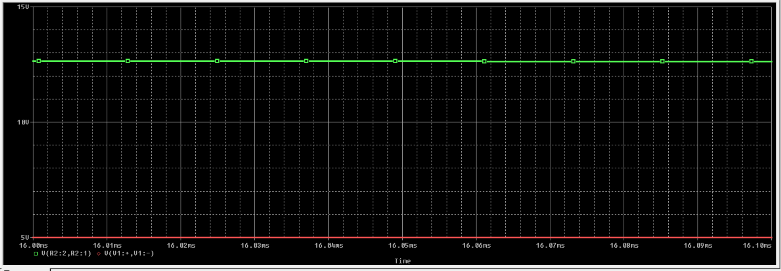
Using Voltage Markers to view Output and Input Voltage:

Slide 9
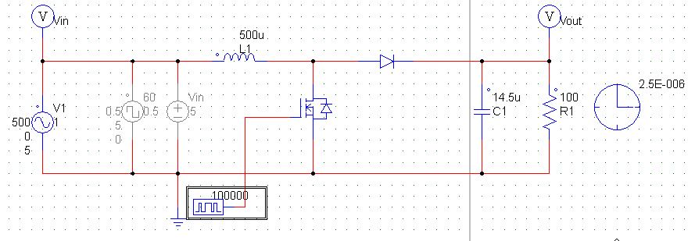
Designing the controller.
Using PSSIM, and a non-constant input voltage signal:

Slide 10
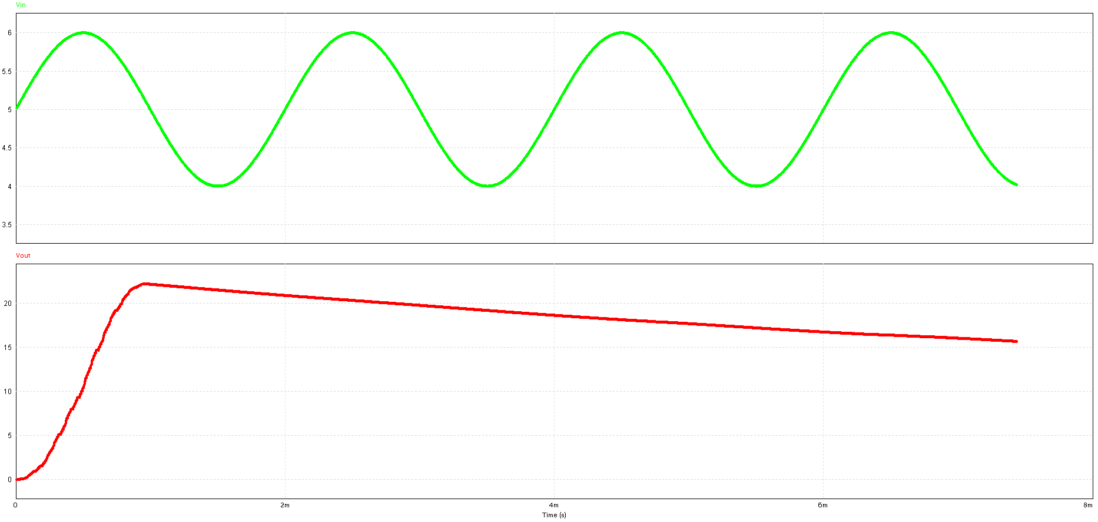

Slide 11
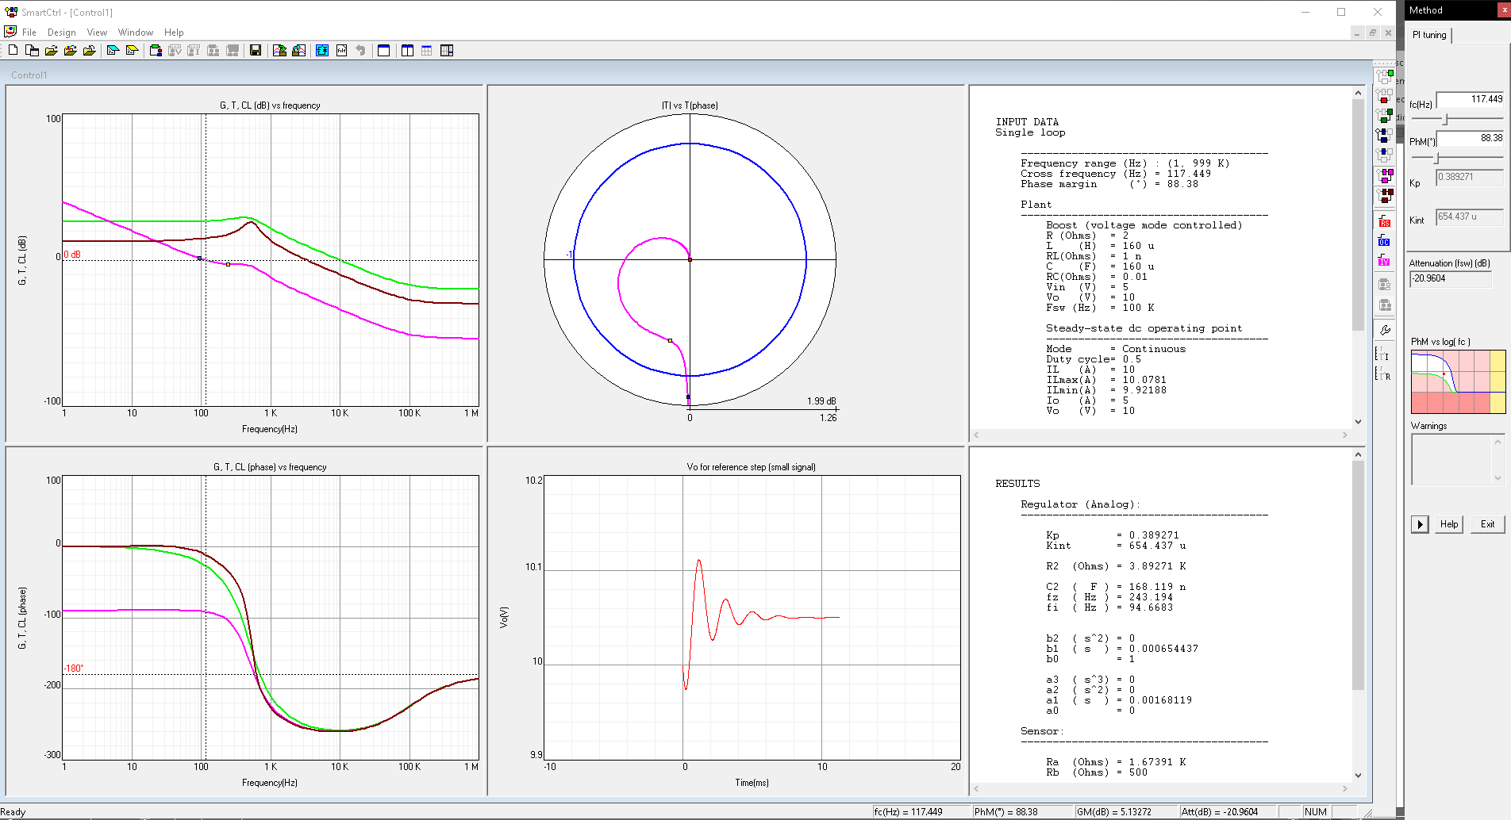

Slide 12
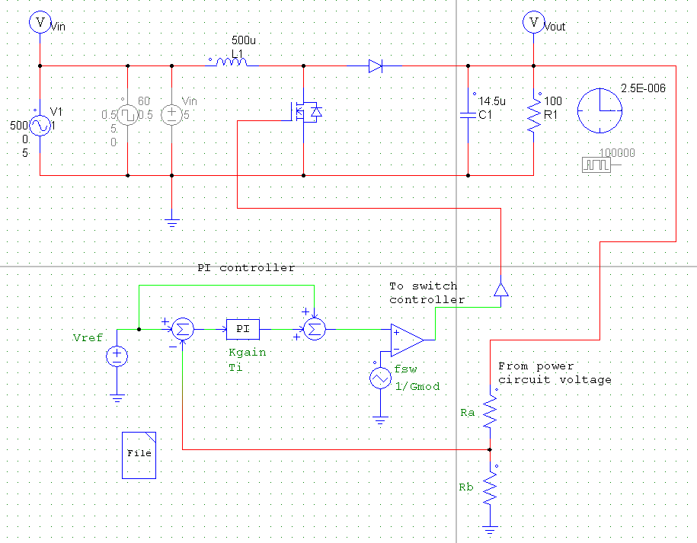

Slide 13
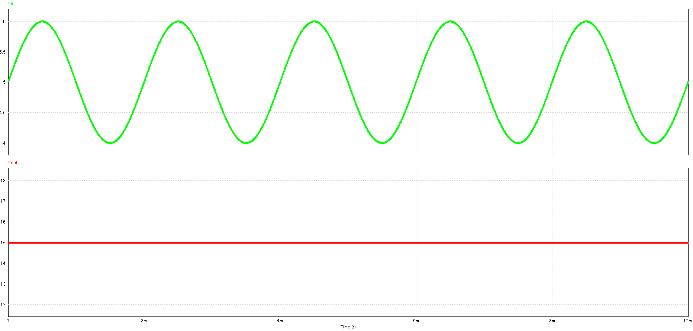
Then, with the controller implemented, the resulting voltage output:

Slide 14
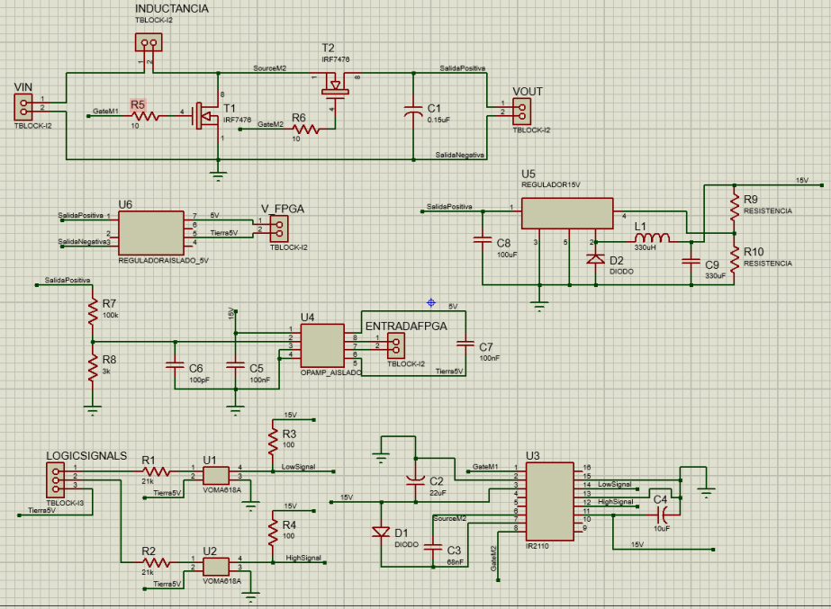
Designing the PCB:
Schematic circuit:

Slide 15
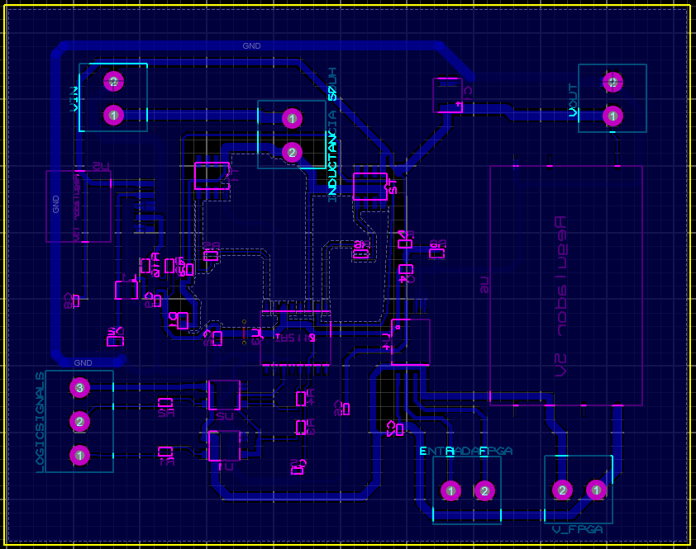
Placing the components as Layout:

Slide 16
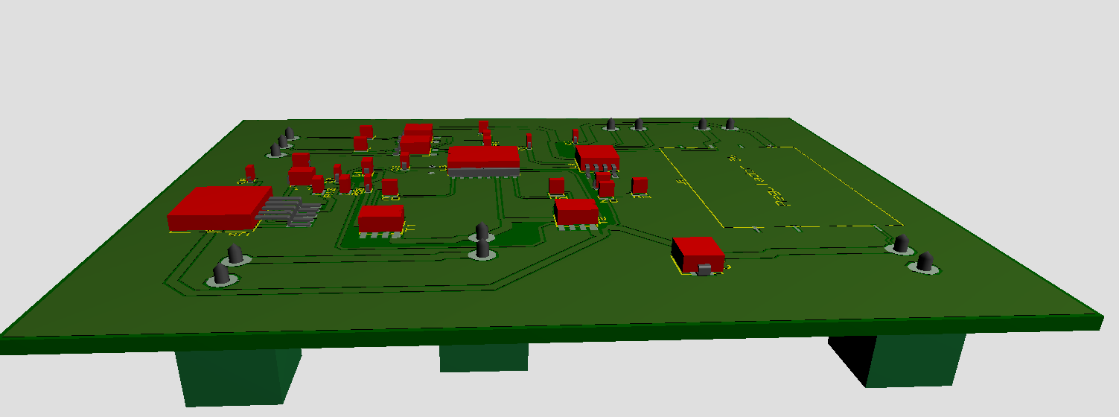

Slide 17
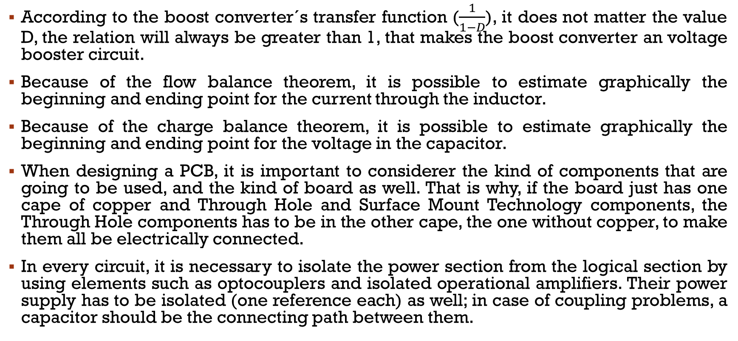
Conclusions:
According to the boost converter´s transfer function ($\frac{1}{1−D}$), it does not matter the value D, the relation will always be greater than 1, that makes the boost converter an voltage booster circuit.
Because of the flow balance theorem, it is possible to estimate graphically the beginning and ending point for the current through the inductor.
Because of the charge balance theorem, it is possible to estimate graphically the beginning and ending point for the voltage in the capacitor.
When designing a PCB, it is important to considerer the kind of components that are going to be used, and the kind of board as well. That is why, if the board just has one cape of copper and Through Hole and Surface Mount Technology components, the Through Hole components has to be in the other cape, the one without copper, to make them all be electrically connected.
In every circuit, it is necessary to isolate the power section from the logical section by using elements such as optocouplers and isolated operational amplifiers. Their power supply has to be isolated (one reference each) as well; in case of coupling problems, a capacitor should be the connecting path between them.

